Slide 1

Department of Foreign Languages
MAJOR PAPER
Title: A linguistic game booklet to engage sixth graders
in French speaking lessons.
Authoress: Carmen Lilian Monteagudo González
Advisors: Deyse Matilde Fernández González , M. A.
Miguel Alejandro Fernández Torres, B.Ed.
Academic year: 2019-2020
, March, 2020

Slide 2

TELL ME, I’LL FORGET.
SHOW ME, AND I MAY REMEMBER.
BUT INVOLVE ME AND I’LL UNDERSTAND
Asian Proverb

Slide 3
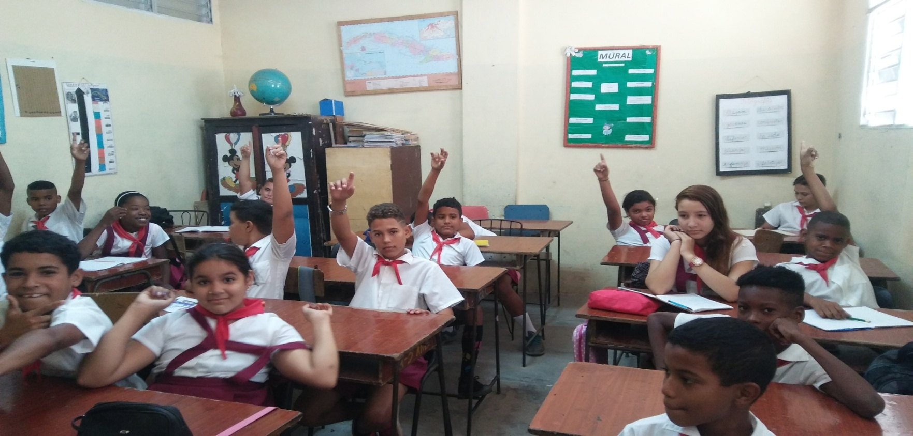

PROBLEMATIC SITUATION

Slide 4
Scientific problem
How to improve engagement in learning the French speaking skill in sixth graders from "Zeneido Costa Llerena" Elementary School?
Object of research
Improvement of engagement in learning the French speaking skill in sixth graders from "Zeneido Costa Llerena" Elementary School.
Objective
To build up a booklet of linguistic games to improve engagement in learning the French speaking skill in sixth graders from" Zeneido Costa Llerena" Elementary School.

Slide 5
Scientific questions
1. What theoretical and methodological foundations back up the improvement of engagement in learning the French speaking skill?
2. What is the current situation regarding engagement in learning the French speaking skill in sixth graders at "Zeneido Costa Llerena" Elementary School?
3. What new changes could improve engagement in learning the French speaking skill in sixth graders at "Zeneido Costa Llerena" Elementary School?
4. What went well and what did not go well during the introduction of new changes to improve engagement in learning French speaking skill in sixth graders at “Zeneido Costa Llerena" Elementary School?
5. What transformations take place in sixth graders at "Zeneido Costa Llerena" Elementary School during the implementation of the new changes?
6. What final scientific result emerges from the building up process?
Scientific tasks

Slide 6
Research methods
From the Theoretical
Level
  Historical-logical
  Analytic-synthetic
  Inductive-deductive
  System approach
  Percentage analysis
From the Statistic-
Mathematical Level
  Document analysis
  Learning Research Journal
  Interview
  Survey
  Pedagogical test
  Triangulation
  Participant observation
From the Empirical
Level

Slide 7

DISCUSSION

Slide 8
1. Theoretical and methodological foundations
that back up the teaching and learning
process of the speaking skill in French
language.
1.1 Historical antecedents of the teaching and learning process of
French language in Cuba
1.2. The development of the speaking skill
1.3. Young learners
1.4.The role of engagement in the foreign language learning
classroom
1.5.The use of games for engaging the students in the foreign
language learning classroom
Notes:
8

Slide 9
Psychological characteristics of the subjects of research
Sixth graders at “Zeneido Costa LLerena” Elementary School in Santa Clara.
Most of them have a large amount of energy. They are very creative, active and curious.
None of the students had any experience in learning French, but they were willing to learn French as a foreign language. Thus, they are considered beginners.
They are highly motivated to learn French and learn better when the teacher provides ludic activities.
They have only one class period (45 minutes) a week to practice this language.

Slide 10
Categories
COGNITIVE
BEHAVIORAL
EMOTIONAL

Slide 11
SUBCATEGORIES | INSTRUMENTS
Knowledge Knowledge about French speaking countries Knowledge about French speaking people culture | Survey Participant observation (I) Interview
Abilities Abilities in pronouncing French difficult sounds Abilities to imitate the pronunciation of French words and short phrases. | Participant observation (I) Interview

Slide 12
SUBCATEGORIES | INSTRUMENTS
Spontaneous participation in class Compulsory participation in class Will to take the risk | Survey Participant observation (I) Interview
Indifference to the French lesson Motivation to learn French Engagement in the French speaking lessons | Participant observation (I) Interview

Slide 13
Regularities
Strengths
All the students are motivated towards learning French and its culture.
All the students are eager to learn a new language.
The students express their will of being more engaged during the lessons
They are disciplined and could concentrate with ease.

Slide 14
Weaknesses
The students had limited information about French speaking countries
The students´ participation in class, either spontaneous or compulsory, was very poor.
The students hesitated to take the risk in pronouncing or imitating sounds and words.
The students were not able to be completely involved in the first lessons because of their difficulties in pronunciation and in imitating French sounds and words.
The regularities detected demonstrated that the students are in what the Common European Framework of Reference (CEFR) calls an A-zero level.

Slide 15
3. Building- up process
of the final scientific result
INITIAL PROPOSAL: a system of eight linguistic games which followed the communicative language teaching principles
AIM: to improve students´ engagement in French speaking lessons

Slide 16

FINAL PROPOSAL:
A Linguistic game booklet to
engage sixth graders in French speaking lessons.

Slide 17
Linguistic games
1. Jouez et gagnez
2. Le cercle des prénoms
3. La Boule de feu
8. Le jeu du serpent
7. Le pendu
6. Le voyage
5. Ma famille
4. L´horloge de l´amour

Slide 18
One example of the proposal
8. Le jeu du serpent
Avant le jeu :
Unité 6: Qu’est-ce que vous faites dans la vie?
Objectif du jeu :
-intégrer les contenus abordés au fil du cours
-renforcer des valeurs, des habitudes et des savoir-faire
Durée : 45 minutes

Slide 19
Contenus linguistiques :
-Pronoms personnels sujets
-Salutations et adieux
-Accent phonétique
-Pronoms et verbes réfléchis
-Verbes : être, appeler, travailler
-Les chiffres
-Structure :"Il est…"
-Articles définis
-Adjectifs possessifs
-Membres de la famille
-Préposition avec
-Professions et métiers
-Prononciation des sons : /œ/, /r/, /y/, /e/, /ã/, /u/, le son /Ø/ en position finale
-Intonation montante et descendante
-La liaison et l’élision
Contenus communicatifs :
-Saluer
-Prendre congé
-Les expressions de politesse
-Se présenter
-Demander et dire l’heure
-Parler des membres de la famille
-Parler des professions
Outils : des tableaux, des cartes, des dés, des pions, une pièce de monnaie
Lieu : salle de classe

Slide 20
Réglementation :
-Si le couple, un membre du couple, ou les couples déjà éliminés parlent à haute voix.
-Si les couples déjà éliminés disent la réponse à un autre camarade.
-Si le couple ou un membre du couple ne connaît pas la réponse.
-Si le couple ou un membre du couple ne fait pas attention à l´activité.
-Le couple recevra la moitié des points si les apprenants ont des erreurs de prononciation, bien que leur réponse soit correcte.
-Le couple recevra la moitié des points si les apprenants ont des erreurs d’accord/ grammaire, bien que la réponse soit correcte en gros.
-Si un membre du couple n’est pas capable de répondre à une question, il/elle peut passer la question à l´autre camarade, comme ça le jeu peut continuer.
-Si l´autre camarade ne connait pas non plus la réponse, le couple perdra le point.
-Si le couple n’est pas capable de répondre à une question, la question sera passée à un autre couple. Si le deuxième couple répond correctement, il recevra deux points.
-Le couple qui reçoit la carte blanche aura un point en tant que bonus.

Slide 21
Pendant le jeu :
Évaluation de l’état psychologique et physique des apprenants, pour présenter et jouer le jeu en tant que moyen pour attirer leur attention.
Déroulement :
Les apprenants devront organiser douze couples, ils seront disposés face à face. Ainsi, ils seront six confrontations. Une pièce de monnaie est jetée pour décider l´équipe qui commence selon le côté choisi par chaque équipe.
Chaque couple joue chacun son tour en lançant le dé. Suivant le chiffre obtenue, le couple avance son pion case par case. Selon la couleur de la case, ils devront répondre aux questions qui apparaissent dans une carte parmi toutes des cartes qui sont de cette même couleur, jusqu´à un couple arrive à la ligne d´arrivée.

Slide 22
Après le jeu :
Chaque confrontation aura un couple des gagnants. Ainsi, six couples seront les gagnants et seront classés depuis le 6ème au 1er lieu.
-Corriger les erreurs des apprenants.
-Favoriser l´auto-évaluation et l´inter- évaluation.
-Favoriser les réflexions des apprenants.

Slide 23
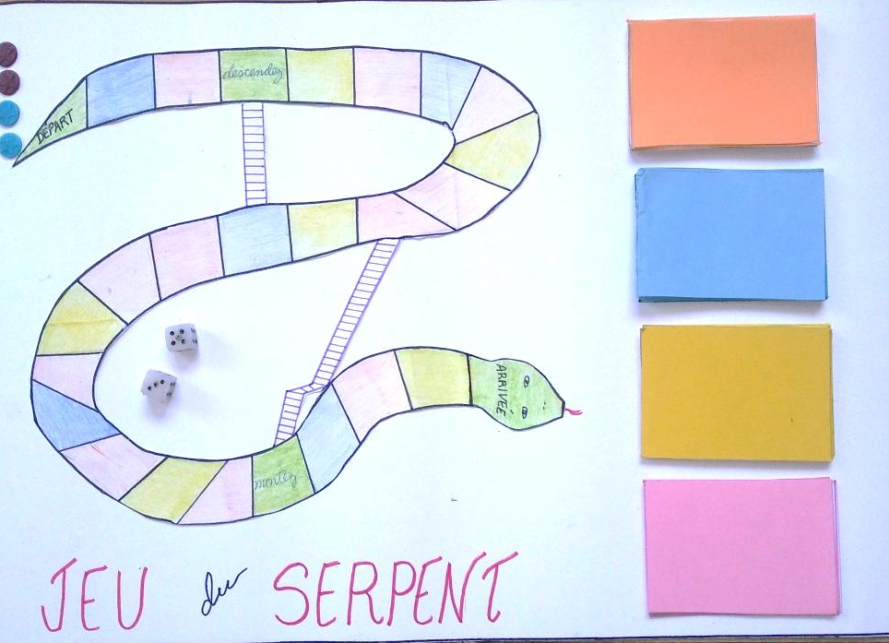

Slide 24
Students´ transformations after the building up process of the final scientific result

Slide 25
Conclusions
1. The proposal consisting of “A linguistic game booklet to engage sixth graders in French speaking lessons” was based on a communicative perspective to language teaching, on the main characteristics of the speaking skill, as well as on the role of engagement and games in the teaching learning process of foreign languages.
2. The empirical instruments administered revealed that the subjects of research had limited information about French speaking countries and the French culture because they are true beginners as French learners, it was also noticed that they were eager and motivated to learn the French speaking skill and that they needed ludic activities to be more involved in learning French as it was the second foreign language they were learning.

Slide 26
3. The introduction of games revealed that the students were able to get information about French speaking peoples´ culture, that they could participate during the French lessons spontaneously and enthusiastically, and also that they were emotionally engaged in learning the French speaking skill.
4. All the games functioned well as the students participated freely, they were not afraid of taking the risk, and they were highly motivated and involved in learning French as second foreign language. Only some rules were added to keep discipline during the games.

Slide 27
5. The main transformations observed in the subjects of research were linked to their knowledge about French speaking people’s culture, their motivation to learn French and their involvement in the French speaking lessons.
A booklet of linguistic games to engage sixth graders in French speaking lessons, emerged from the building up process as the final scientific result.
Recommendations

Slide 28

Gracias por su atención
Merci de votre attention
Thanks for your attention

Slide 29
Outside critic’s questions
Questions posed by Grisel Elina Moré Rojas, M.A
In the problematic situation, the authoress states that students have a
little knowledge about French speaking countries as well as their culture. How does your proposal contribute to achieve students’ sociocultural competence?
2. In the need assessment the authoress offers information about the subjects of research. Taking into account their psychological characteristics and the number of students. How do you deal with classroom management to carry out the activities of your proposal?
3. The proposal presented is a booklet of games to engage sixth graders in French speaking lessons. What benefits does it offer in language learning?

Slide 30
Question 1:
1. In the problematic situation, the authoress states that students have a little knowledge about French speaking countries as well as their culture. How does your proposal contribute to achieve students’ sociocultural competence?
Communicative competence
(Hymes, 1972)
the capacity that should be developed
in the students to produce and process
written or oral texts in a coherent way.
Communicative
approach
Linguistic or grammatical competence
Sociolinguistic competence
Strategic competence
(Canale M,
1983)
Discourse competence
Sociocultural Competence

Slide 31
Question 2:
2. In the need assessment the authoress offers information about the subjects of research. Taking into account their psychological characteristics and the number of students. How do you deal with classroom management to carry out the activities of your proposal?
Ideas which were needed to conduct the games from the Practice of English Language Teaching written by Jeremy Hamer.
Problem behavior and what to do about it
Relaxed atmosphere
Teachers´ role
Teachers should make more conscious use of a principal teaching talent: Voice

Slide 32
Question 3:
3. The proposal presented is a booklet of games to engage sixth graders in French speaking lessons. What benefits does it offer in language learning?
Emotional intelligence: the ability, capacity, skill,
or self-perceived ability to identify, assess, and
manage the emotions of oneself, of others
and of groups
Goleman (quoted in Oza et al,2014)

Slide 33

Is there a link between
emotional intelligence
and language learning?

Slide 34
Aspects of emotional intelligence:
(Goleman, 1996)
• Self awareness
• Self regulation
• Motivation
• Empathy
• Social skills

Slide 35
Benefits
(Hamanová, 2016)
Games have a motor function when motivating the students to do the activity and to get results.
Games are very useful for socialization and promote cooperative learning.
Games improve the student-student social relationships and teacher-student interaction since the teacher will know them better after playing the game.
Game implementation in a language learning classroom is a part of the cognitive process, as it contributes to promote students´ thinking process and to develop their communicative competence.
Games promote students´ active participation and encourage them to take risks.
Games reinforce students´ self-control and strengthen respect for people because they have to respect the rules and learn to win or to lose.
Games engage the students because they develop the activity, the creativity and the cooperation among the students.

Slide 36


